Slide 1
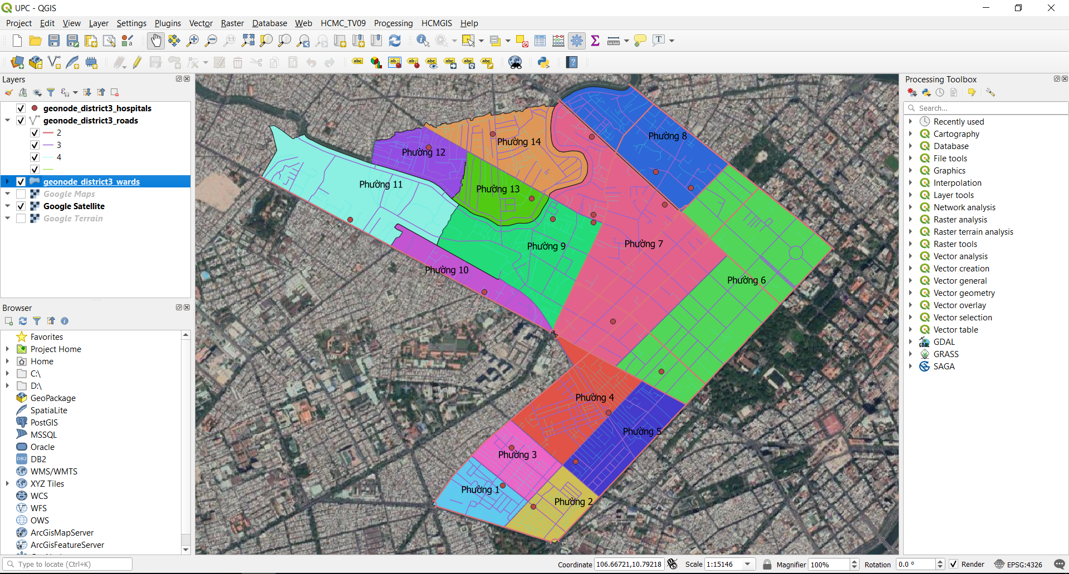
QGIS COURSE OUTLINE

Slide 2
COURSE OUTLINE
Course name: QGIS Basics
Length: 5 days
Goal: Mastering QGIS GUI and basic Tools
Methods: Hands-on, Step by step.
Sample Data: Download from HCMGIS OpenData
References:
https://docs.qgis.org/3.10/en/docs/,
https://docs.qgis.org/3.10/en/docs/training_manual/
https://docs.qgis.org/3.10/en/docs/gentle_gis_introduction/

Slide 3
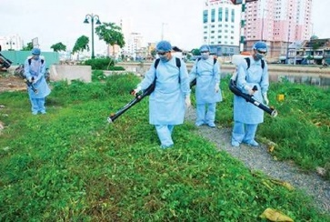
COURSE OUTLINE
Time | Contents
1st Day | QGIS Overview, how to download and install Useful Terms: Metadata, Encoding, CRS Understanding QGIS Project, how to install and use Plugins Overview of the interface: Menu, Layers list, Browser Panel, Drag and drop, Toolbars, Map Canvas, Status Bar HCMGIS Plugin: Add Basemap, Vietnamese Font Converter, Merge/ Split files,…
2nd Day | File and data types: Shapefile, CSV, GeoPackage, SpatiaLite, PostGIS, MSSQL, Oracle, DB2, WMS, XYZ Tiles, WFS, ArcGIS Mapserver, GeoNode Loading Data: Add tool, QGIS Browser, reordering layers Layer Properties: Symbology (Single Symbol, Categorized Symbol), Label Working with Layer Attribute: view/ sort attribute, select feature by expressions, add/ remove fields, calculate field Adding AutoCAD, MicroStation Files Export layer, convert geometry type

Slide 4
COURSE OUTLINE
Time | Contents
3rd Day | Useful terms: Geoid, Ellipsoid, Datum, EPSG… Coordinate systems: Geographic Coordinate system, Projected Coordinate system Coordinate Reference System in QGIS: “On the fly” projection, VN-2000 ←→ WGS84 CRS transfer Define a new custom projection in QGIS for each Provinces in Vietnam
4th Day | Processing tools in Vector menu, Processing Toolbox Attribute join, Spatial Join Check validity, fix geometries Clip, intersection, union
5th Day | Editing Mode, Add new feature, Edit Feature. Compose a print layout Course review

Slide 5
About me
Designing and building professional solutions and GIS applications supporting management in urban technical infrastructure, natural resources - environment matters and economic - cultural - social issues
Name: Quach Dong Thang, quachdongthang@gmail.com, 0933908919
Education:
2008: Master of Science in Cartography, Remote Sensing and Geographic Information System (GIS), HCMC University of Technology.
2003: Bachelor of Science in Mathematics and Computer Science , HCMC University of Natural Science.
Employment:
2008 – now:
Employer: Center for Applied GIS of HCM City
Position held: Head of Technology Development Division
Job Duties: Designing and building professional solutions and GIS applications supporting management in urban technical infrastructure, natural resources - environment matters and economic - cultural - social issues.

Slide 6
About me
Designing and building professional solutions and GIS applications supporting management in urban technical infrastructure, natural resources - environment matters and economic - cultural - social issues
Participated Projects/ Research Subjects:
Ho Chi Minh City Sewerage Master Plan Update and Adjustment (Package TV-09 - WB Loan), 2018 – present.
Building Spatial Database Infrastructure for HoChiMinh City, 2016 – 2018.
Updating road network geodatabase to support metro line planning projects of HCM City - funded by Japanese ODA, 2016.
Building WebGIS application for market and shopping center management and planning of HCM City, 2016.
Applying LiDAR technology for updating the road network geodatabase of HCM City, 2014.

Slide 7
Keep Calm and enjoy Learning!
https://hcmgis.vn
HCMGIS – GIS for the City, GIS for the Community

